Slide 1


DineFilter
🍽️🍕🔍

Slide 2
The Problem
Finding restaurants matching specific preferences is time-consuming
Difficult to get comprehensive information in one place
Reviews are scattered and unstructured
Menu information often requires visiting multiple sites

Slide 3
Solution: Restaurant Recommendation Agent
AI-powered restaurant search and recommendation engine
Crawls Google Maps and restaurant websites
Analyzes reviews to extract key insights
Provides structured, actionable recommendations

Slide 4
Natural language query understanding
Google Maps integration (location, ratings, reviews)
Website content crawling for menus
Review sentiment analysis
Price and cuisine filtering
Contextual recommendations

Slide 5
Technology Stack
Python with asyncio for concurrency
LangGraph for workflow orchestration, Langchain
GPT-4 for natural language understanding
Apify actors:
Google Maps Scraper
Website Content Crawler

Slide 6
Demo
{
"prompt": "I'm looking for Italian restaurants in Manhattan with good pasta dishes for a date"
}

Slide 7
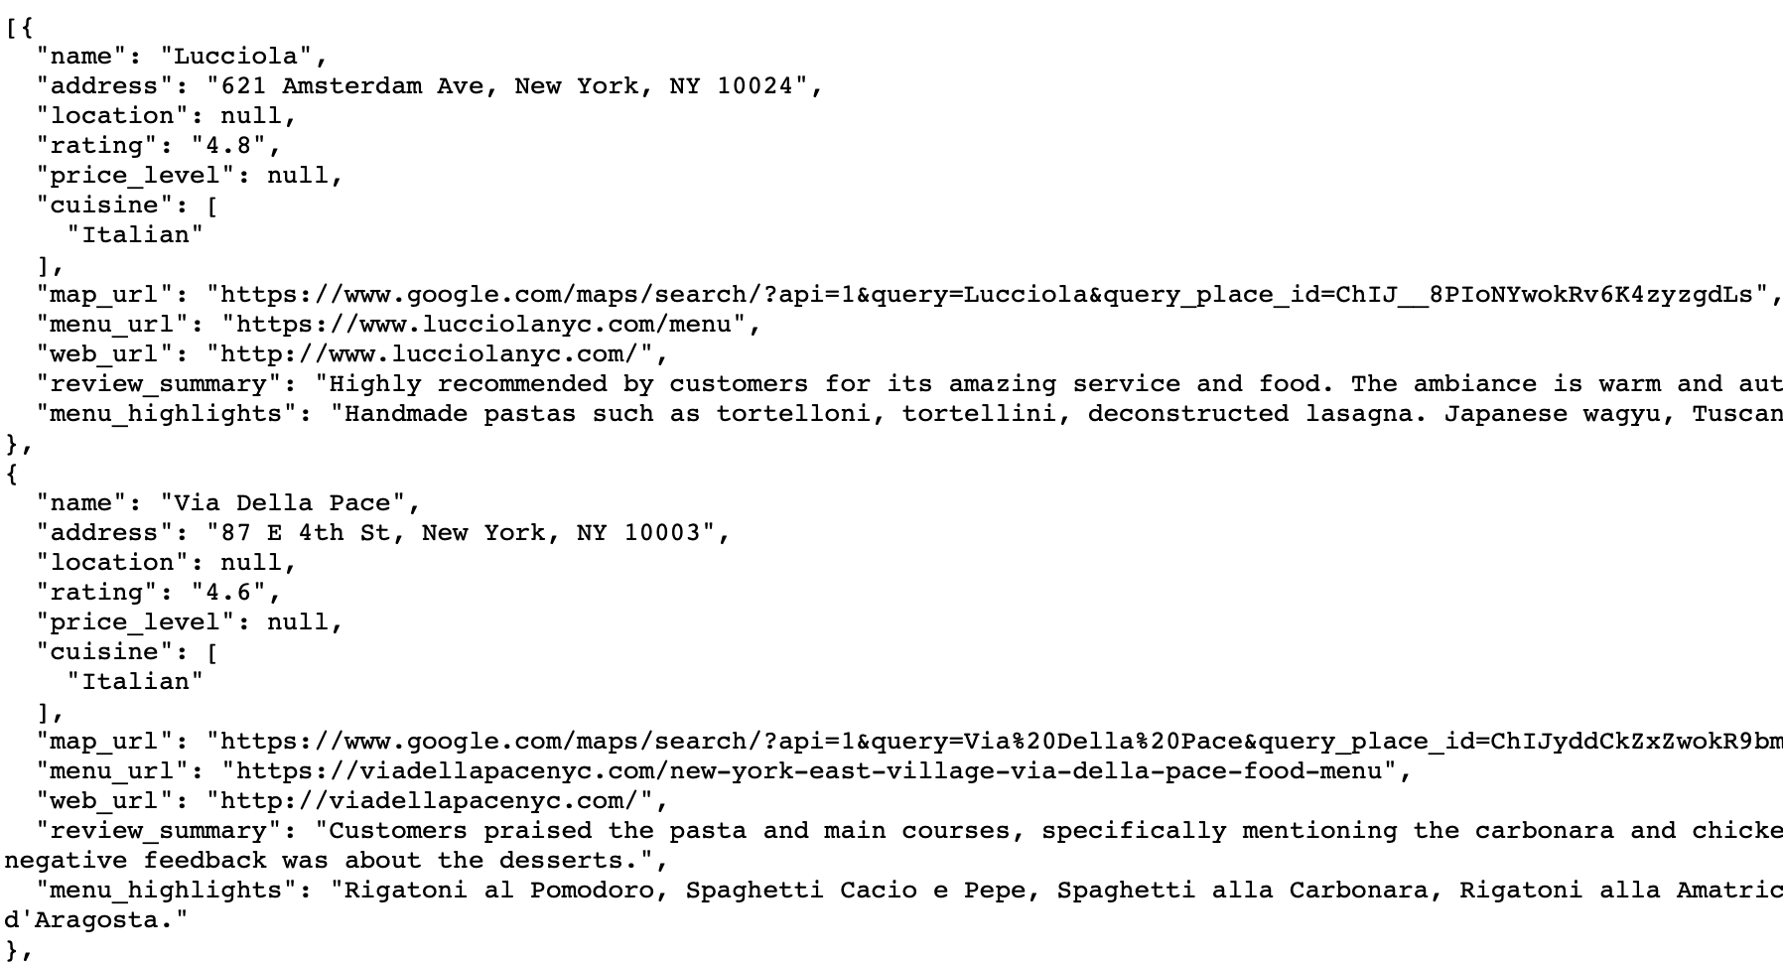
Notes:
https://api.apify.com/v2/datasets/aOCCv9DItSWZ4FnYZ/items?clean=true&format=json&limit=1000

Slide 8
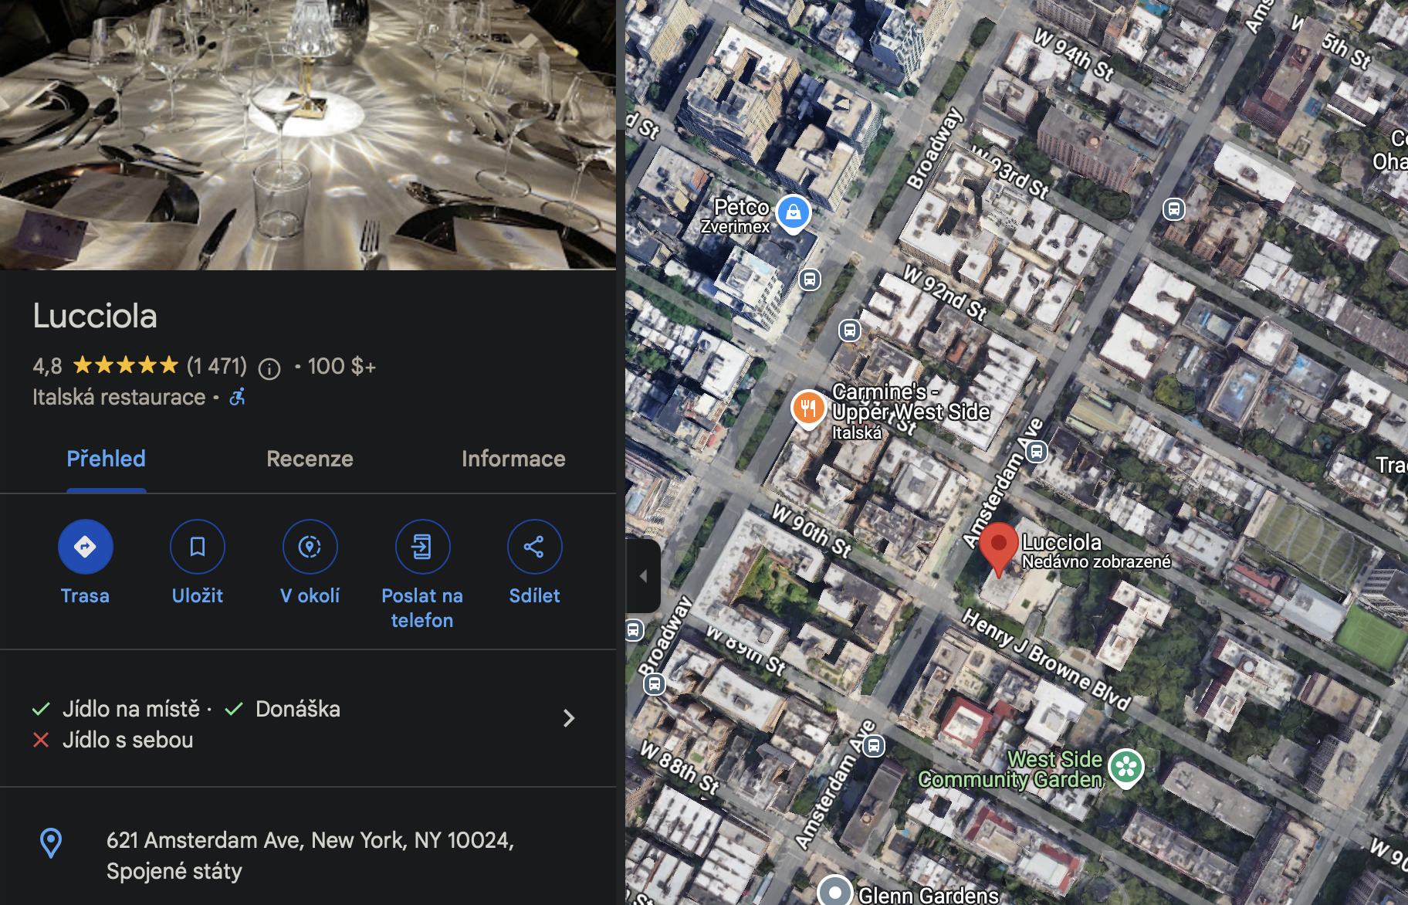
Lucciola
Highly recommended by customers for its amazing service and food. The ambiance is warm and authentic. Some customers find it overpriced.
Handmade pastas such as tortelloni, tortellini, deconstructed lasagna. Japanese wagyu, Tuscan fiorentina, Italian baeri caviar, and Trikalinios bottarga.

Slide 9
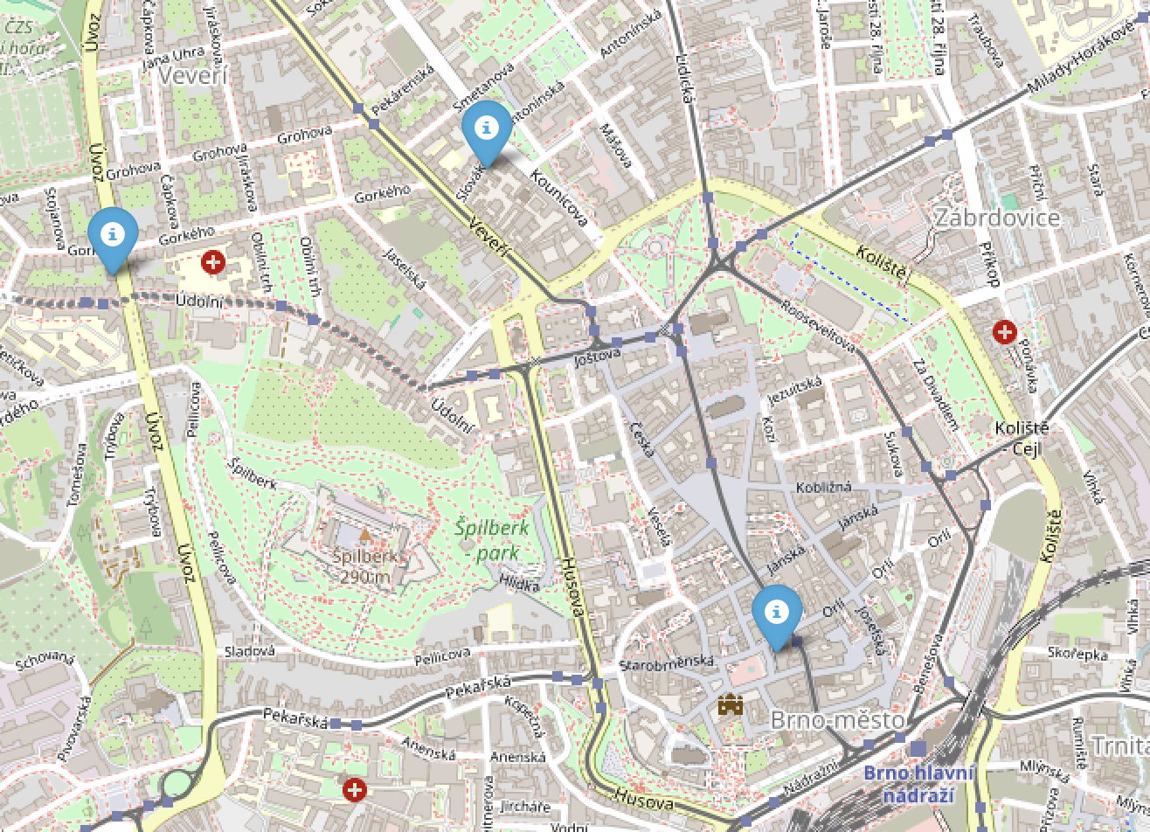
Best Brno downtown restaurants
You go figure it out with our actor where are they :D

